Slide 1
INTRODUCTION TO PARALLEL AND DISTRIBUTED COMPUTING

Slide 2
Introduction to Parallel and Distributed Computing
Parallel and Distributed Computing is a field of computer science that focuses on solving problems using multiple computing resources at the same time. Instead of relying on a single computer or processor, tasks are divided and executed across multiple processors or computers.
This subject is important because modern applications process large amounts of data and require high-speed computation. Examples include weather forecasting, artificial intelligence, online banking systems, and scientific simulations.

Slide 3
Meaning of Parallel Computing
Parallel computing is a computing method where multiple processors work together simultaneously to solve a problem. A large task is divided into smaller tasks that are executed at the same time.
The main goal of parallel computing is to improve speed and efficiency. Examples include image processing, machine learning, and scientific research applications.

Slide 4
Meaning of Distributed Computing
Distributed computing involves multiple computers connected through a network working together to achieve a common goal. Each computer contributes resources and processing power.
Distributed systems improve reliability and scalability. Examples include cloud storage systems and online search engines.

Slide 5
Importance of Parallel and Distributed Computing
Parallel and distributed computing help organizations process large volumes of data quickly. They reduce execution time and improve system performance.
These technologies support modern applications such as social media platforms, online banking, and cloud services. They are essential in today's digital world.

Slide 6
High Performance Computing (HPC)
High Performance Computing refers to the use of powerful computers and clusters to perform complex calculations at very high speeds. HPC systems combine multiple processors and large memory resources.
HPC is used in weather prediction, medical research, and engineering simulations. It allows scientists and researchers to solve complex problems efficiently.

Slide 7
Characteristics of High Performance Computing
HPC systems provide high speed, large storage capacity, and powerful processing capabilities. They are designed to handle computationally intensive tasks.
These systems are important because they reduce the time required for large-scale computations. They help organizations make faster and more accurate decisions.

Slide 8
Introduction to Parallel Programming
Parallel programming is the process of writing programs that execute multiple tasks simultaneously. The program is divided into smaller units called threads or processes.
This approach improves performance and resource utilization. It is widely used in scientific computing and real-time systems.

Slide 9
Some Benefits of Parallel Programming
Parallel programming reduces program execution time by allowing tasks to run concurrently. It also improves system efficiency and responsiveness.
Organizations use parallel programming to handle large datasets and complex calculations. It supports modern applications that require high performance.

Slide 10
Parallel Architecture
Parallel architecture refers to the design of computer systems that support parallel execution. These systems contain multiple processors or cores.
The architecture allows tasks to be processed simultaneously. Examples include multicore processors and supercomputers

Slide 11
A Parallel Computing Architecture
A Parallel Computing Architecture (often modeled as a Symmetric Multiprocessor or SIMD system) features multiple processors working collaboratively on a single task. The processors share a centralized memory bank and communicate over a high-speed internal bus network to divide large computations and execute them concurrently.

Slide 12
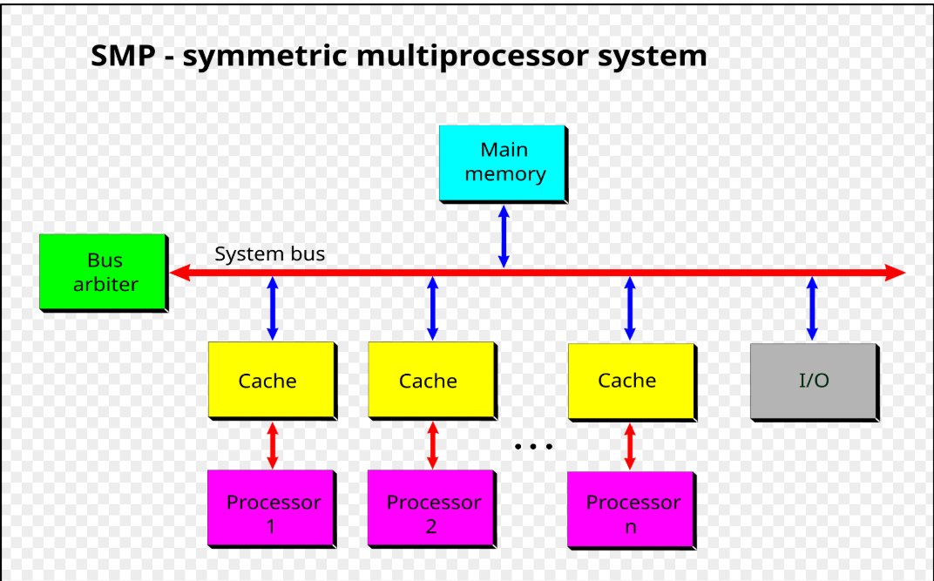
Symmetric Multiprocessor System

Slide 13
Symmetric Multiprocessor System
A bus arbiter is a specialized controller or logic unit that manages access to a shared communication pathway (a "bus") in a computer system or electronic device
A cache (pronounced "cash") is a high-speed, temporary data storage area. Its primary purpose is to store frequently accessed data so that future requests for that data can be loaded significantly faster, saving time and system resources.

Slide 14
Types of Parallel Architecture
Common types include shared memory systems and distributed memory systems. Shared memory systems allow processors to access the same memory.
Distributed memory systems use separate memory units connected by a network. Both architectures are widely used in modern computing.

Slide 15
Cloud Computing
Cloud computing provides computing resources over the internet. Users can access servers, storage, and applications without owning physical hardware.
Cloud services offer flexibility, scalability, and cost savings. Examples include online storage and web hosting services.

Slide 16
Advantages of Cloud Computing
Cloud computing reduces hardware costs and improves accessibility. Users can access services from anywhere with an internet connection.
Organizations use cloud computing to improve collaboration and business continuity. It supports large-scale distributed applications.

Slide 17
Distributed Systems
A distributed system consists of multiple computers working together as a single system. These computers communicate through a network.
Distributed systems improve performance, reliability, and scalability. Examples include online banking and e-commerce platforms.

Slide 18
Components of Distributed Systems
The main components include nodes, networks, communication protocols, and software services. Each component plays a specific role in system operation.
Understanding these components helps students design and manage distributed environments effectively.

Slide 19
Distributed Operating Systems
A distributed operating system manages multiple networked computers and makes them appear as one system. It coordinates resources and communication.
Examples include Amoeba and Plan 9. These systems improve resource sharing and system efficiency

Slide 20
Functions of Distributed Operating Systems
These systems manage files, processes, memory, and communication across networked computers. They ensure efficient resource utilization.
Their primary goal is to provide transparency and simplify system management for users.

Slide 21
Network Protocols
Network protocols are rules that govern communication between computers. They ensure reliable data exchange across networks.
Examples include TCP/IP, HTTP, and FTP. These protocols form the foundation of distributed computing.

Slide 22
Importance of Network Protocols
Protocols ensure data is transmitted correctly and efficiently. They support communication between devices and applications.
Without protocols, distributed systems would not function properly. They are essential for network reliability.

Slide 23
Process Communication
Process communication allows processes to exchange information and coordinate activities. It is a key concept in distributed computing.
Examples include message passing and shared memory communication. Effective communication improves system performance.

Slide 24
Kernels in Distributed Systems
The kernel is the core component of an operating system. It manages hardware resources and system operations.
In distributed systems, kernels coordinate communication and resource allocation among multiple computers.

Slide 25
Synchronization
Synchronization ensures that multiple processes access shared resources in an orderly manner. It prevents conflicts and inconsistencies.
Examples include semaphores and mutexes. Synchronization is important for maintaining data integrity.

Slide 26
Need for Synchronization
Without synchronization, processes may interfere with each other. This can lead to incorrect results and system failures.
Proper synchronization improves reliability and efficiency in parallel and distributed systems.

Slide 27
Scheduling
Scheduling determines the order in which processes execute. It helps maximize processor utilization and system performance.
Examples include First Come First Serve (FCFS) and Round Robin scheduling algorithms

Slide 28
Scheduling Algorithms
Different algorithms are used depending on system requirements. Some focus on fairness while others focus on speed.
Understanding scheduling helps students optimize system performance and resource allocation.

Slide 29
Exceptions in Distributed Systems
Exceptions are unexpected events that occur during program execution. Examples include network failures and hardware faults.
Exception handling ensures that systems continue operating even when problems occur.

Slide 30
Deadlocks
A deadlock occurs when processes wait indefinitely for resources held by one another. This prevents progress in the system.
Deadlocks reduce system efficiency and must be prevented or resolved.

Slide 31
Deadlock Prevention
Deadlock prevention uses strategies that avoid conditions leading to deadlocks. Resource allocation policies are commonly used.
Preventing deadlocks improves system stability and performance.

Slide 32
Deadlock Resolution
Deadlock resolution identifies and removes deadlocks when they occur. Techniques include process termination and resource recovery.
These methods ensure system operations continue normally.

Slide 33
Client-Server Systems
A client-server system consists of clients requesting services from servers. The server processes requests and returns responses.
Examples include web applications and online banking systems.

Slide 34
Advantages of Client-Server Systems
Client-server systems centralize resources and improve management. They provide better security and scalability.
Many modern applications use this architecture because of its efficiency.

Slide 35
Web-Based Collaborative Systems
Web-based collaborative systems allow users to work together through the internet. Examples include Google Docs and Microsoft Teams.
These systems improve communication and teamwork across different locations.

Slide 36
Features of Collaborative Systems
Collaborative systems support document sharing, communication, and real-time updates. They improve productivity and coordination.
Organizations use them for remote work and project management.

Slide 37
Concurrency in Computing
Concurrency occurs when multiple processes execute during overlapping time periods. It improves resource utilization.
Concurrency is common in operating systems, databases, and distributed applications.

Slide 38
Concurrency Issues
Common issues include race conditions, deadlocks, and resource conflicts. These problems can affect system correctness.
Understanding concurrency issues helps developers design reliable systems.

Slide 39
APIs for Distributed Application Development
Application Programming Interfaces (APIs) provide tools for building distributed applications. APIs simplify communication between software components.
Examples include REST APIs and Java APIs. They improve software development efficiency.

Slide 40
Java RMI
Java Remote Method Invocation (RMI) allows Java programs to communicate across networks. It enables remote object interaction.
Java RMI is widely used for distributed application development and experimentation.

Slide 41
Cluster Computing
A cluster is a group of connected computers working together as a single system. Clusters improve performance and reliability.
Organizations use clusters for scientific research and large-scale computations.

Slide 42
Experimental Projects in Distributed Computing
Students use distributed environments to develop and test applications. Experimental projects provide practical experience.
These projects improve problem-solving and programming skills.

Slide 43
Real-World Applications
Parallel and distributed computing support artificial intelligence, cloud services, healthcare systems, and financial systems.
These technologies enable organizations to process large datasets and deliver services efficiently.

Slide 44
Summary and Future Trends
Parallel and distributed computing continue to evolve with cloud computing, edge computing, and artificial intelligence. These technologies are shaping the future of computing.
Students who understand these concepts can contribute to innovative solutions in science, business, and technology.

Slide 45
QUICK QUIZ 1
1. What is the main goal of parallel computing? A. Increase processing speed B. Reduce storage devices C. Remove networks D. Create databases
2. Distributed computing involves: A. One computer only B. Multiple computers working together C. One processor D. One network cable
3. High Performance Computing is mainly used for: A. Complex calculations B. Playing games only C. Typing documents D. Printing files
4. Which of the following is an example of a network protocol? A. TCP/IP B. Microsoft Word C. Excel D. PowerPoint
5. Synchronization is used to: A. Coordinate shared resources B. Delete files C. Install software D. Create hardware
6. A deadlock occurs when: A. Processes wait indefinitely for resources B. Data is saved C. Programs start D. Computers shut down

Slide 46
QUICK QUIZ 1
7. Cloud computing provides resources through: A. The Internet B. Printers C. Scanners D. USB drives
8. Java RMI stands for: A. Java Remote Method Invocation B. Java Resource Management Interface C. Java Random Memory Integration D. Java Runtime Module Interface
9. Which architecture consists of clients requesting services from servers? A. Client-Server Architecture B. Peer-to-Peer Only C. Standalone System D. Single User System
10. Which issue is common in concurrent systems? A. Race Condition B. File Printing C. Data Typing D. Screen Resolution

Slide 47
Possible Solutions
A
B
A
A
A
A
A
A
A
A

Slide 48
Thank You

